Slide 1
Call At Rumor
CALL AT RUMOR
RUMOR?
TRAIN!
Call At Rumor® 2020 V0.01 alpha prototype

Slide 2

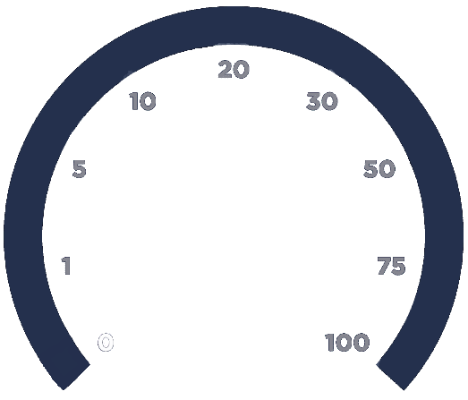

Call At Rumor Trainer
EPOCH
LOSS
ACCURACY
0
0.00
00.00
Hardware resource: GPU
USE
IMPORT DATASET
MENU
EXPORT
ADVANCED
BEGIN TRAINING
0%
Data Complete
Call At Rumor® 2020 V0.01 alpha prototype

Slide 3
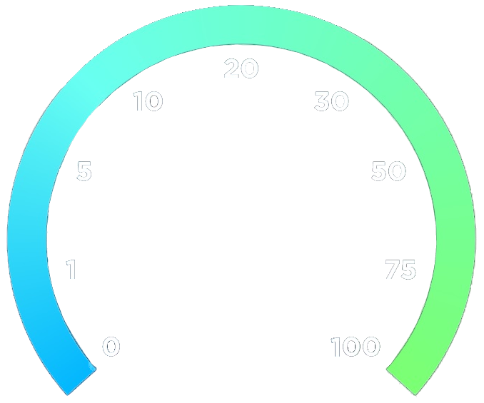
Call At Rumor Trainer
EPOCH
LOSS
ACCURACY
4
0.05
98.84
Hardware resource: GPU
USE
IMPORT DATASET
MENU
EXPORT
ADVANCED
BEGIN TRAINING
100%
Data Complete
Call At Rumor® 2020 V0.01 alpha prototype

Slide 4
Call At Rumor Trainer
EPOCH
LOSS
ACCURACY
4
0.05
98.84
Hardware resource: GPU
USE
IMPORT DATASET
MENU
EXPORT
BEGIN TRAINING
Training Time Start time: 07-Jun-2020 18:07:27 Elapsed time: 38 sec
Training Cycle Epoch: 4 of 4 Iteration: 232 of 232 Iteration per epoch: 58 Maximum iterations: 232
100%
Data Complete
Call At Rumor® 2020 V0.01 alpha prototype

Slide 5
Call At Rumor
CALL AT RUMOR
RUMOR?
Language
Trained Data
Test Subject
English US (Default)
English US V0.02 (Newest)
Import Required
MENU
GO
Call At Rumor® 2020 V0.01 alpha prototype

Slide 6
Call At Rumor
CALL AT RUMOR
RUMOR?
Language
Trained Data
Test Subject
English US (Default)
English US V0.02 (Newest)
Import Required
English US (Default) Hebrew Russian
MENU
GO
Call At Rumor® 2020 V0.01 alpha prototype

Slide 7
Call At Rumor
CALL AT RUMOR
RUMOR?
Language
Trained Data
Test Subject
English US (Default)
English US V0.02 (Newest)
Import Required
English US V0.01
Import Pre-Trained Data
MENU
GO
Call At Rumor® 2020 V0.01 alpha prototype

Slide 8

Call At Rumor
CALL AT RUMOR
RUMOR?
Language
Trained Data
Test Subject
English US (Default)
English US V0.02 (Newest)
Import Required
English US V0.01
Import Pre-Trained Data
MENU
GO
…
C:\Users\Romeo\Documents\Hebrew_v0.02.aiData
Call At Rumor® 2020 V0.01 alpha prototype

Slide 9
Call At Rumor
CALL AT RUMOR
RUMOR?
Language
Trained Data
Test Subject
English US (Default)
English US V0.02 (Newest)
Import Required
Import Posts
MENU
GO
…
C:\Users\Romeo\Documents\myPosts.txt
Call At Rumor® 2020 V0.01 alpha prototype

Slide 10
Call At Rumor
CALL AT RUMOR
RUMOR?
Language
Trained Data
Test Subject
English US (Default)
English US V0.02 (Newest)
Loaded Successfully!
MENU
GO
Call At Rumor® 2020 V0.01 alpha prototype

Slide 11

Call At Rumor
CALL AT RUMOR
RUMOR?
Language
Trained Data
Test Subject
English US (Default)
English US V0.02 (Newest)
Loaded Successfully!
MENU
Rumor
68% Rumor 32% Non-Rumor
Call At Rumor® 2020 V0.01 alpha prototype

Slide 12
Call At Rumor
CALL AT RUMOR
RUMOR?
Language
Trained Data
Test Subject
English US (Default)
English US V0.02 (Newest)
Loaded Successfully!
MENU
Not A Rumor
08% Rumor 92% Non-Rumor
Call At Rumor® 2020 V0.01 alpha prototype

Slide 13
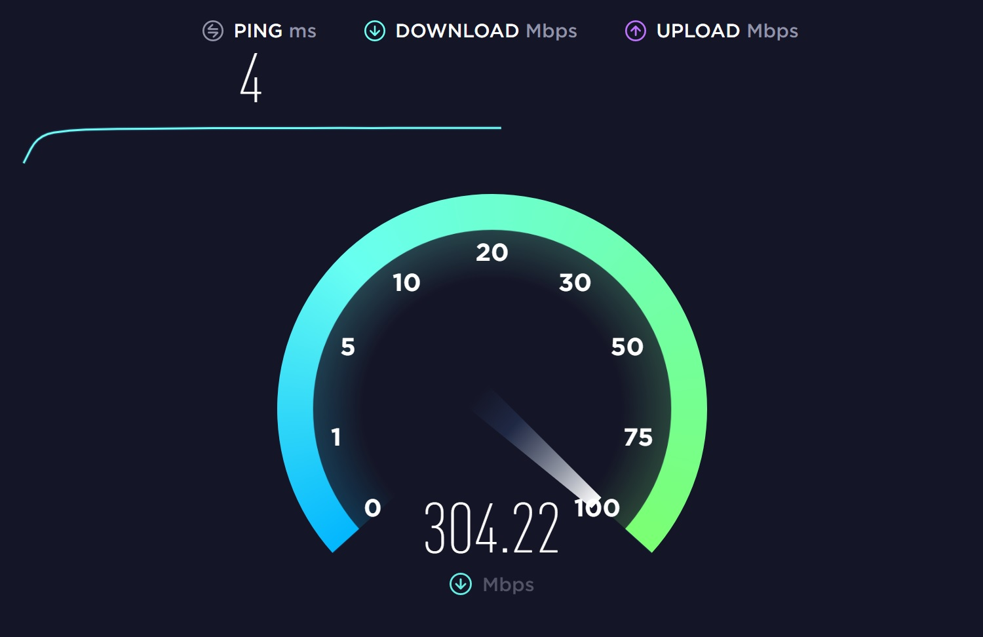


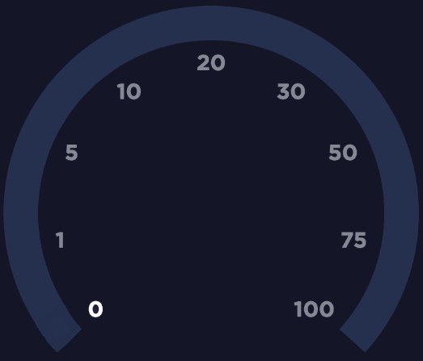

Call At Rumor Trainer
EPOCH
LOSS
ACCURACY
0
0.00
00.00
Hardware resource: GPU
USE
MENU
EXPORT
ADVANCED
BEGIN TRAINING
0%
Data Complete
Call At Rumor® 2020 V0.01 alpha prototype

Slide 14

Call At Rumor Trainer
EPOCH
LOSS
ACCURACY
0
0.00
00.00
Hardware resource: GPU
USE
MENU
EXPORT
ADVANCED
BEGIN TRAINING
0%
Data Complete
Call At Rumor® 2020 V0.01 alpha prototype

Slide 15
Call At Rumor
CALL AT RUMOR
RUMOR?
TRAIN!
Call At Rumor® 2020 V0.01 alpha prototype

Slide 16
Call At Rumor
CALL AT RUMOR
RUMOR?
TRAIN!
Call At Rumor® 2020 V0.01 alpha prototype

